Slide 1
Unit 2
Frequency domain filtering

Slide 2
Fourier Transforms
Named after Joseph Fourier
Any periodic function can be represented as a weighted sum of infinite sinusoids of different frequencies
Fourier transforms represent a signal f(x) in terms of Amplitudes and Phases of its constituent Sinusoids.
f(x) F(u)
F for each u captures the amplitude and the phase of the corresponding sinusoid wave
FT

Slide 3
Inverse Fourier Transforms
Captures the signal f(x) from the Amplitudes and Phases of its constituent Sinusoids.
f(x) F(u)
F for each u captures the amplitude and the phase of the corresponding sinusoid wave
There is no loss of information in the forward and backward direction of the transform
IFT

Slide 4

Fourier Transform in 1D
F$\left(u\right)= \int_{−∞}^{∞}{f(x)e^{−i2πux}}$dx
Where x : space
u: frequency
$e^{iθ}=cosθ+i sinθ$
i=sqrt(-1)
Inverse Fourier Transform
$f\left(x\right)= \int_{−∞}^{∞}{F(u)e^{i2πux}}$du

Slide 5
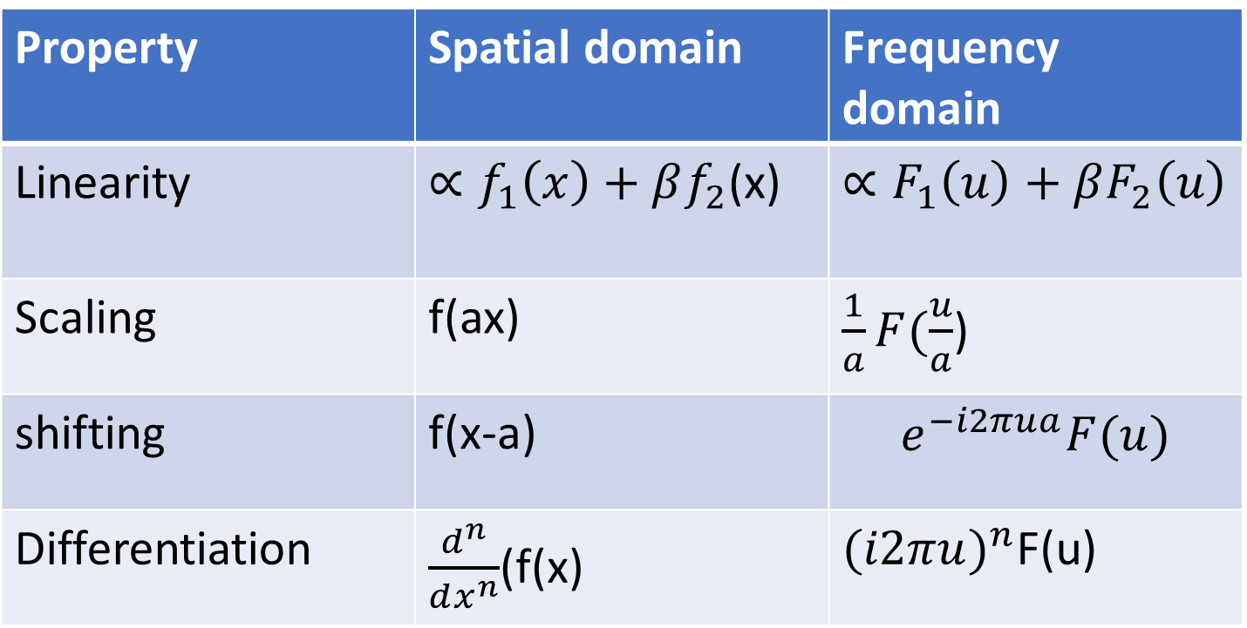
Spatial Domain vs Frequency Domain
Property | Spatial domain | Frequency domain
Linearity | $∝f_{1}\left(x\right)+βf_{2}$(x) | $∝F_{1}\left(u\right)+βF_{2}\left(u\right)$
Scaling | f(ax) | $\frac{1}{a}F(\frac{u}{a}$)
shifting | f(x-a) | $$e^{−i2πua}F(u)$$
Differentiation | $\frac{d^{n}}{dx^{n}}$(f(x) | ${(i2πu)}^{n}$F(u)

Slide 6
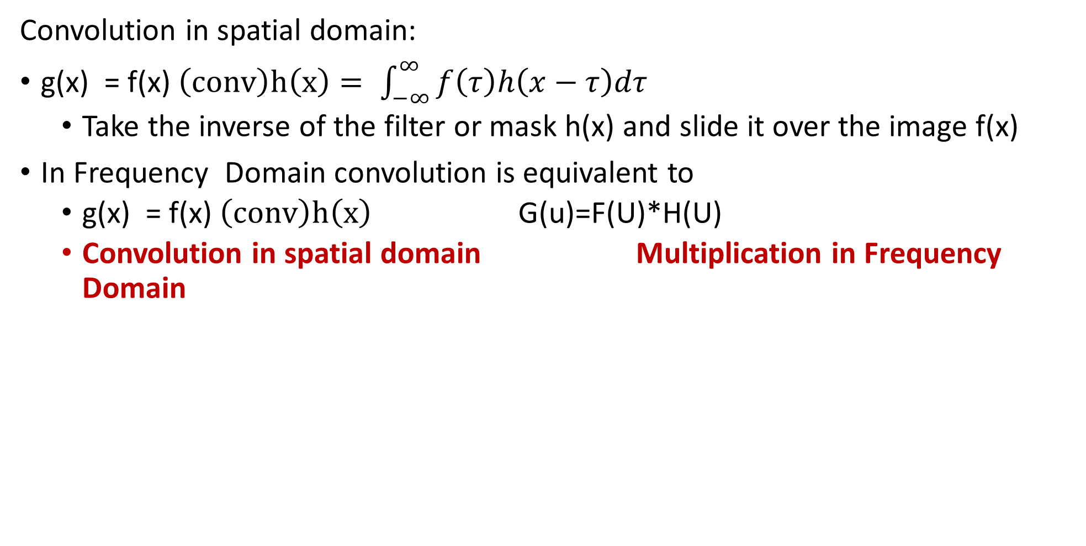
Convolution and Fourier Transform
Convolution in spatial domain:
g(x) = f(x) $\left(conv\right)h\left(x\right)= \int_{−∞}^{∞}{f\left(τ\right)h\left(x−τ\right)dτ}$
Take the inverse of the filter or mask h(x) and slide it over the image f(x)
In Frequency Domain convolution is equivalent to
g(x) = f(x) $\left(conv\right)h\left(x\right)$ G(u)=F(U)*H(U)
Convolution in spatial domain Multiplication in Frequency Domain

Slide 7
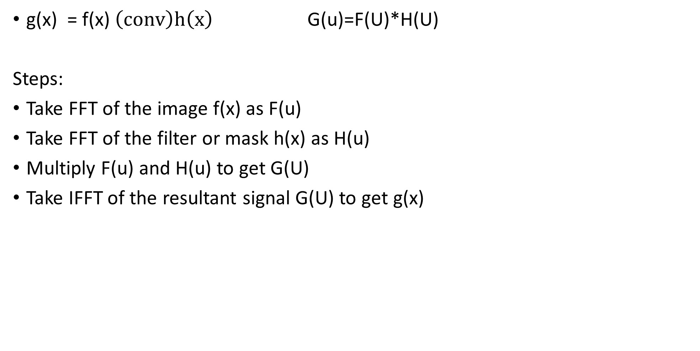
Steps for Convolution in Fourier Transform
g(x) = f(x) $\left(conv\right)h\left(x\right)$ G(u)=F(U)*H(U)
Steps:
Take FFT of the image f(x) as F(u)
Take FFT of the filter or mask h(x) as H(u)
Multiply F(u) and H(u) to get G(U)
Take IFFT of the resultant signal G(U) to get g(x)

Slide 8
Advantage
The algorithm for doing FFT and IFFT are very fast
Spatial filtering on images using large kernels is a very expensive and time-consuming process
This can be done much faster using FFTs in frequency domain

Slide 9
Low frequency: slow variation in intensity values
e.g. wall of a room or blue sky without clouds
High frequency: sharp transitions in intensity values
e.g. edges or noise
Low Pass Filter: allows only the low-frequency components to be passed to the transformed image
Cuts off the higher frequency components
Used for smoothening operations
High Pass Filter: allows only the high-frequency components to be passed to the transformed image
Cuts off the lower frequency components
Used for sharpening operations

Slide 10

Fourier Transforms in 2D
Fourier Transform
$F\left(u,v\right)= \iint_{−∞}^{∞}{f(x,y)e^{−2πi(ux+vy)}}dxdy$
u and v are frequencies along x and y respectively
Inverse Fourier Transform
$f\left(x,y\right)= \iint_{−∞}^{∞}{F(u,v)e^{2πi(ux+vy)}}dud$v

Slide 11

Discrete Fourier Transform
DFT
F[p,q]= $\sum_{m=0}^{M−1}{\sum_{n=0}^{N−1}{f[m,n]e^{\frac{−i2πpm}{{me}^{−i2πqn/N}}}}}$
IDFT
f[m,n]= $\sum_{m=0}^{M−1}{\sum_{n=0}^{N−1}{F[p,q]e^{\frac{i2πpm}{{me}^{i2πqn/N}}}}}$

Slide 12
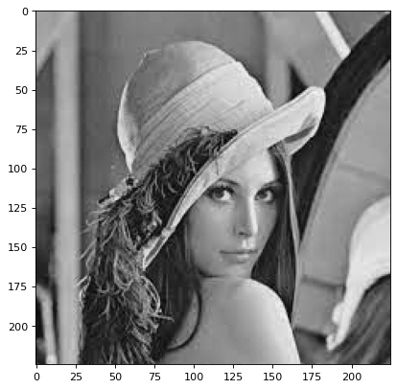
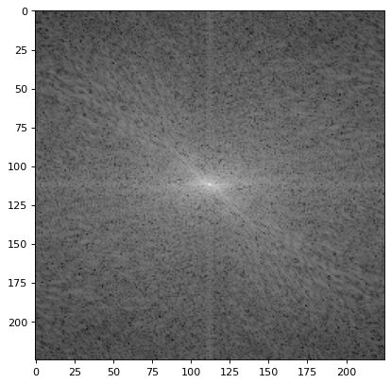

Slide 13
Types of Low pass filters:
Ideal low pass filter(very sharp)
Passes all frequencies within a circle of radius from the origin
Cuts off all frequencies outside this
Circle is called the Ideal Low Pass Filter (ILPF)
Specified by the function:
D₀ is the cut off
D(u,v): is the distance of point (u,v) from the origin

Slide 14

Types of Low pass filters:
Butterworth Low Pass Filter(BLPF)
$$H\left(u,v\right)=\frac{1}{1+[{D(u,v)/D_{0 }]}^{2n}}$$
Where n is the order of the filter
BLPF can be controlled to approach the characteristics of ILPF using higher values of n

Slide 15

Types of Low pass filters:
Gaussian low pass filter (very smooth)
$H\left(u,v\right)= e^{−D^{2}(u,v)/2D_{0}^{2}}$
GLPF can be controlled to approach the characteristics of ILPF using lower values of n

Slide 16
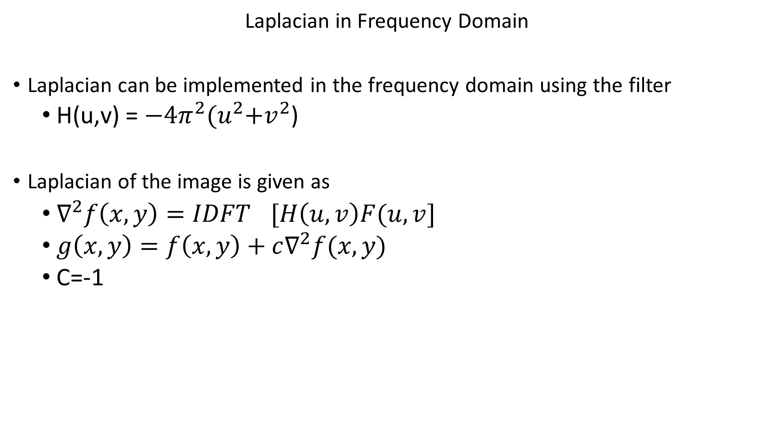
Laplacian in Frequency Domain
Laplacian can be implemented in the frequency domain using the filter
H(u,v) = $−4π^{2}{(u}^{2}+v^{2}$)
Laplacian of the image is given as
$∇^{2}f\left(x,y\right)={IDFT}^{}[H\left(u,v\right)F(u,v]$
$g\left(x,y\right)=f\left(x,y\right)+c∇^{2}f(x,y)$
C=-1

Slide 17
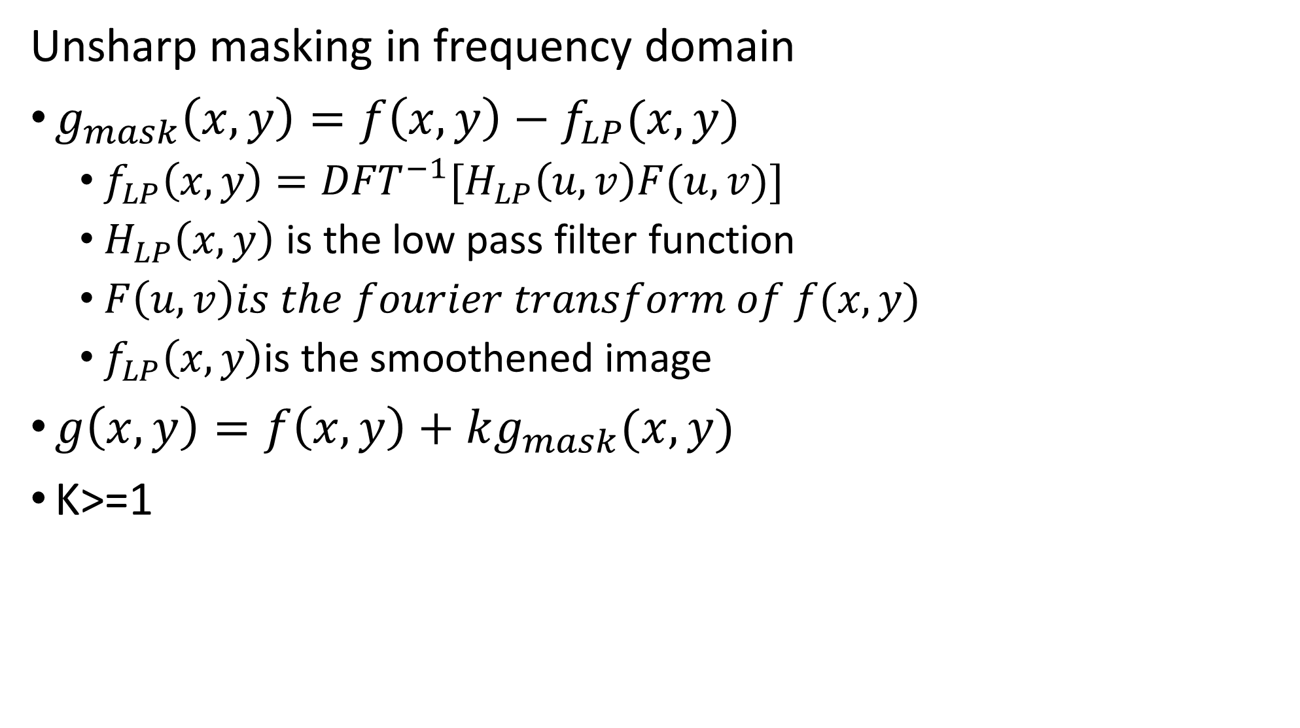
Unsharp masking in frequency domain
$g_{mask}\left(x,y\right)=f\left(x,y\right)−f_{LP}(x,y)$
$f_{LP}\left(x,y\right)={DFT}^{−1}[H_{LP}\left(u,v\right)F(u,v)]$
$H_{LP}\left(x,y\right)$ is the low pass filter function
$F\left(u,v\right)is the fourier transform of f(x,y)$
$f_{LP}\left(x,y\right)$is the smoothened image
$g\left(x,y\right)=f\left(x,y\right)+kg_{mask}(x,y)$
K>=1

Slide 18
Fourier Transform in Python
Read the image
Convert to gray scale
Calculate FFT
f_image = np.fft.fft2(gray_image)
There are three kinds of frequency components in the image
Low-frequency components: correspond to smooth and gradual changes, while
high-frequency components: represent abrupt changes and fine details.
The DC component, or zero frequency:represents the average brightness of the image.
Shift the DC or zero-frequency components to the center and compute the magnitude spectrum
fshift = np.fft.fftshift(f_image)

Slide 19
5. Visualize the magnitude spectrum
calculate the magnitude of the complex numbers obtained from the Fourier Transform and plot them
magnitude_spectrum = 20 * np.log(np.abs(fshift)) plt.imshow(magnitude_spectrum, cmap='gray') plt.title('Magnitude Spectrum') plt.axis('off') plt.show()

Slide 20
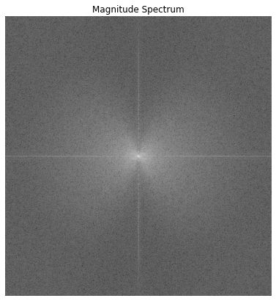

Slide 21
DC component:located at the center of the magnitude spectrum.
Low frequency component: found closer to the center of the magnitude spectrum, surrounding the DC component.
Low frequencies contain more image information than higher ones, as their magnitude is higher.
High frequency component: found towards the outer edges of the magnitude spectrum
capture the abrupt changes, fine details, edges, textures, or noise within the image

